Slide 1
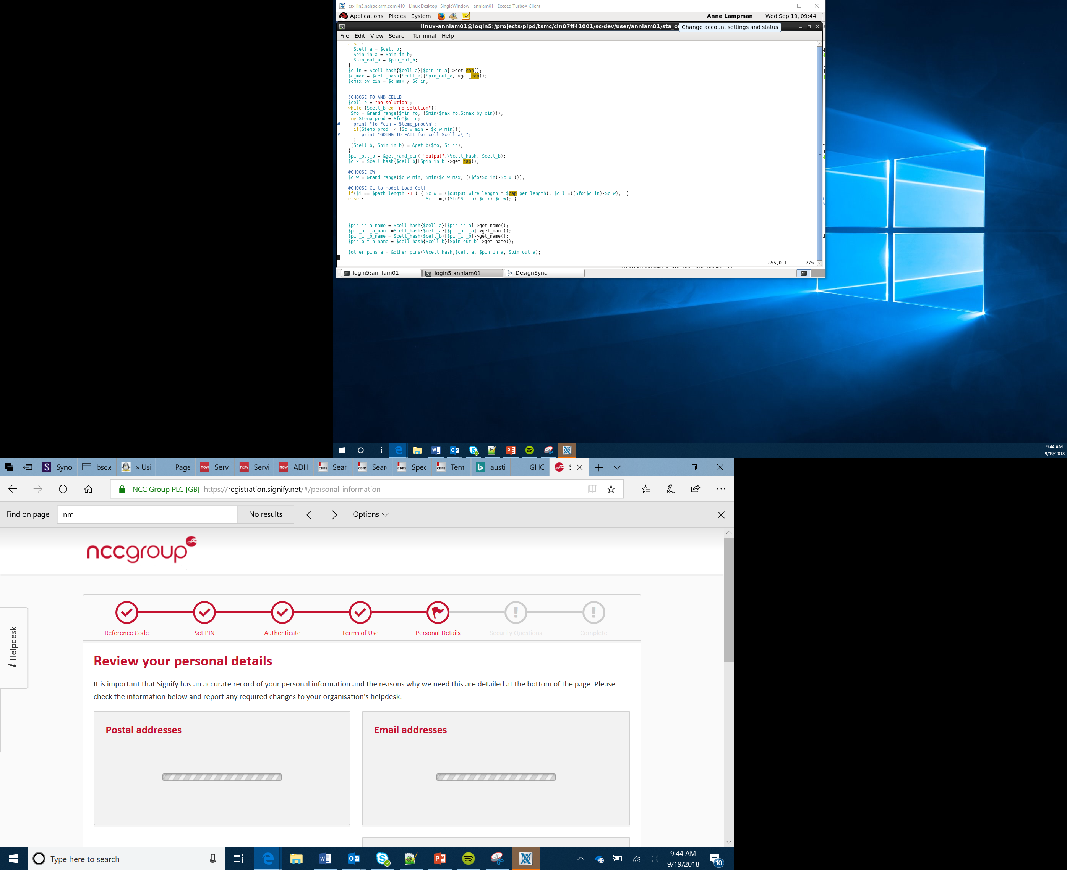

Text-based programming languages
Lesson 20

Slide 2
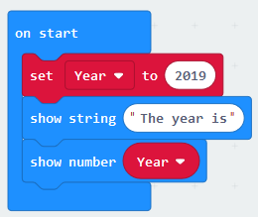
Types of Programming Language
In this course you have used a block-based programming language on the MakeCode website
Today you are going to learn how to use a text-based programming language called Python
Block programs act like jigsaw puzzles where you fit the pieces together. In a text-based language you have to type in the commands yourself. Many of the keywords however are colour coded which will help you to spot any errors
Notes:
Explain to learners that so far they have used a block-based programming language. Today they are going to explore how a text-based language can be used. The language that they are going to use is called Python which is one of the most popular languages in the world. The Google search engine was created using Python. Highlight the key differences between block- and text-based languages. The blocks are dragged and dropped to fit together like a jigsaw, whereas with a text-based language commands have to be typed in. There are however some similarities. The blocks are colour coded, as are commands in Python. They both use the code structures of sequence, selection and iteration.

Slide 3

Python IDLE
When you launch IDLE it will launch in interactive mode. To start a new program you should select File, New File from the main menu
When we write programs, we are going to write them in subroutines. This means that when we write larger programs which we want to reuse we can just run the subroutine rather than having to write it out again
In the code above the def is used to define a subroutine. The subroutine above is named myFirst Program(): You will notice that once you press enter the code will be indented. This means that any code that is indented is part of this subroutine
Notes:
Demonstrate the key functionality in Python IDLE. All students should create the Hello World program. If you do not have IDLE installed it is possible to also use the Python engine in https://replit.it. Talk students through how to create a subroutine.

Slide 4

myFirstProgram
A print statement has been added to the subroutine. The print command is in purple. If it doesn’t appear in purple, it means that there is a typo. The green text highlights that it is a text string that will be output. Note that the string is in quotes (“”)
You then need to save the program
To run the program you should press F5
Try entering the program for yourself and run it. What happens?
Notes:
Explain the purpose of the colour coding. When the students run the program nothing will happen. Ask if anyone knows why. It is because when they run it they haven’t actually called the subroutine. If you are using an alternative IDE the colour coding of different elements of the code may be different.

Slide 5

Running a subroutine
When you write a subroutine you also need to call it. Initially the subroutine is stored for later use until it is called. This means that we can call the subroutine as many times as we want to
To call the subroutine you simply need to type in the name of the subroutine
Try adding this line to your code to make sure that it runs
Well done, you have written your first computer program in a text-based language using a subroutine
Notes:
Demonstrate this program to learners on the MakeCode website. This will ensure that they are aware of where they can locate the sound commands. It will help to generate interest.

Slide 6

Input Statements
We are now going to write a text-based program similar to the one on the right. Instead of typing in the year we are going to ask the user to enter it. To do this we are going to use an input statement.
We have created a new subroutine and this time have added an input statement. When the program is run it will ask the user to “Please enter the year”. Whatever they type in will be stored in the variable Year.
A variable is a named location in memory. It is like a named empty box where we can store something for later use.
Notes:
Explain the structure of the input statement. Highlight what a variable is. Students often find the empty box example a good analogy to follow. Students should then write this program and remember to call the subroutine.

Slide 7

Input Statements 2
We are now going to expand the program to output what the user has typed in along with a piece of text called a string
As you can see in the code above, we have added a new print statement. The start of the print statement is like the “Hello World!” example. You will see that there is a comma followed by the name of the variable. This will print whatever is stored in the variable Year
Complete this program and then work through the Python worksheet
Notes:
Explain the structure of the print statement focusing specifically on the comma and then the variable name.

Slide 8
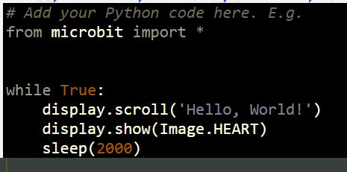
Using Python with the micro:bit
Python programs can be developed to run on the micro:bit
Python Editor for micro:bit (microbit.org) is one IDE that allows you to do this
Run the example program on your micro:bit
Expand the program to display alternative images
Notes:
Demonstrate the micro:bit Python editor. Explain that the import * imports all of the microbit commands that are available in Python.

